Slide 1
Atrial Fibrillation Detection Device
Advisor: Mani Mina
Client: Dr. Rakshak Sarda
Contact: Benjamin Sjulson
Group Members:
Ian Abbott
Seth Rickard
Aaron Melcer
Keegan Mumma
Nicholas Dubois
Donathan Morgan

Slide 2
What is Atrial Fibrillation?
Irregular and often rapid heart rate that can increase the risk of stroke, heart failure and other heart-related complications.
Over 33.5 million people in the world have been diagnosed with Atrial Fibrillation
Symptoms include:
General fatigue
Rapid and Irregular Heartbeat
Fluttering or “Thumping” in the Chest
Dizziness
Shortness of Breath
Weakness
May1615

Slide 3
Intended Users
Lower income areas of the world
Little to no access to professional medical equipment
Largescale use of android based smartphones
India is the 3rd largest smartphone market in the world
Projected to reach 314 million mobile internet users by 2017
Consumer electronics outnumber commercial medical solutions
Intended to be distributed by doctors diagnosing heart problems
May1615

Slide 4
Our Solution
Low cost ECG monitor
Android companion application
Low power MCU
Low power Bluetooth connection core
Algorithm to detect Atrial Fibrillation
May1615

Slide 5
Functional Requirements
Low Power – Can last a day on battery power
Rechargeable – Using commonly available charger
Safety Circuit – Protect user/circuitry from shock
Long Lifespan – Durable components
Bluetooth Connection
Display ECG Output
Detect Atrial Fibrillation
May1615

Slide 6
Nonfunctional Requirements
Easily Wearable
Light weight
Small form factor
Low Cost
Durable
Protective enclosure for circuitry
Intuitive
Simple UI/UX
Easily localizable
May1615

Slide 7
Cost
Component | Cost
Microcontroller (MSP430) | $5
Bluetooth Tx Controller (cc2560) | $6
Instrumentation Amplifier (AD620) | $3
Operational Amplifiers | $2
Resistors/Capacitors | $2
Circuit Board | $10
Li-Ion Batteries | $4
Charging Module | $2
Electrodes | $15
Total | $49
Device components must be of low cost
The android application can be distributed freely
May1615

Slide 8
System Description
May1615

Slide 9
System Description
May1615

Slide 10
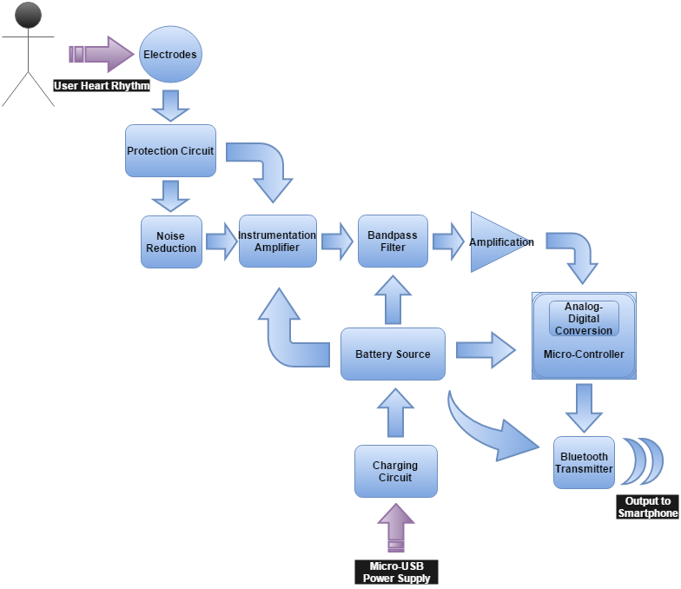
May1615

Slide 11
System Description
May1615

Slide 12
Validation Acceptance Test
The physical device will be thoroughly tested by providing a functional equivalent of an Afib Heart Rate signal
Software can be tested with jUnit tests and Android framework testing
Bluetooth can be stubbed out to confirm that the application is working
Real world testing would begin once the above three testing phases are complete
May1615

Slide 13
Challenges
Creating a reliable connection between the amplification circuit and the subject
Integrating the amplification circuit with the MCU
Integrating the MCU with the Bluetooth controller
Establishing a Bluetooth connection between the hardware and the Android application
Transmitting the heart waveform efficiently to the application
Ensuring testing reflects functionality
May1615

Slide 14
What We Have
Determined Microcontroller to Begin Prototyping
Settled on Bluetooth Transmitter
Working Theoretical Detection Circuit Model
Overall Solution Design
Basis for Detection Circuit Prototype
Functional Android Application
May1615

Slide 15
Milestones
Functional Detection Circuit Prototype
Battery Power Circuit Finalization
Android App Alpha
Program the MCU to Connect with Bluetooth
Connect Bluetooth with Smartphone
Integrate Detection Circuit with MCU and Bluetooth
Data Storage in App
Android App Beta
Pass Acceptance Testing
May1615

Slide 16
Questions?
May1615

